Slide 1
CSE 185 Introduction to Computer Vision
Local Invariant Features

Slide 2
Local features
Interest points
Descriptors
Reading: Chapter 4

Slide 3
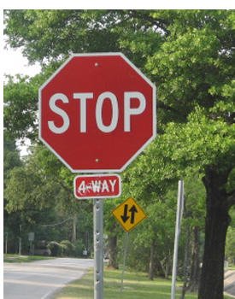


Correspondence across views
Correspondence: matching points, patches, edges, or regions across images
≈

Slide 4
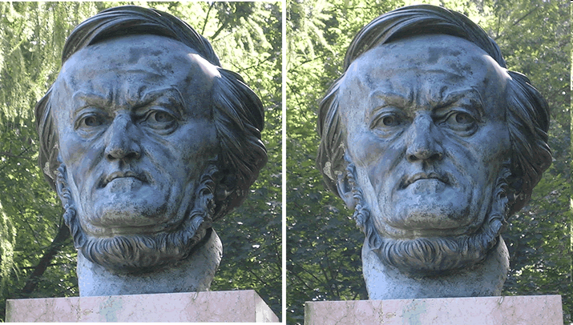
Example: estimating fundamental matrix that corresponds two views

Slide 5
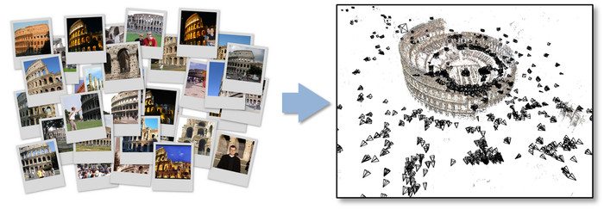
Example: structure from motion

Slide 6
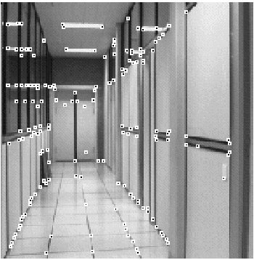
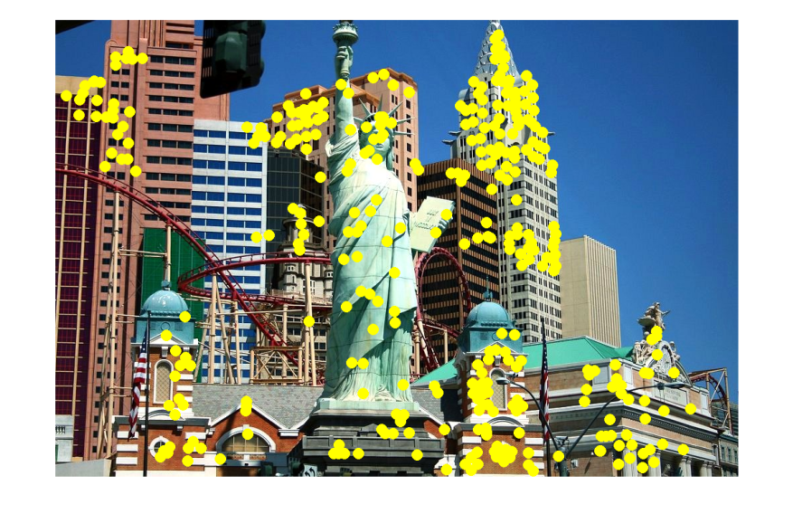
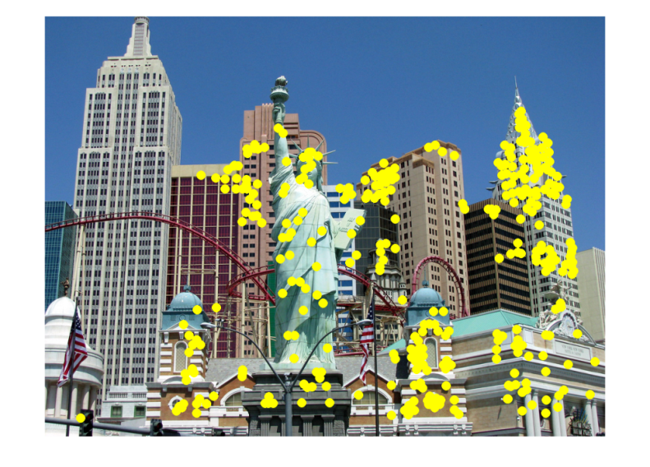
Applications
Feature points are used for:
Image alignment
3D reconstruction
Motion tracking
Robot navigation
Indexing and database retrieval
Object recognition

Slide 7
Interest points
Note: “interest points” = “keypoints”, also sometimes called “features”
Many applications
tracking: which points are good to track?
recognition: find patches likely to tell us something about object category
3D reconstruction: find correspondences across different views

Slide 8
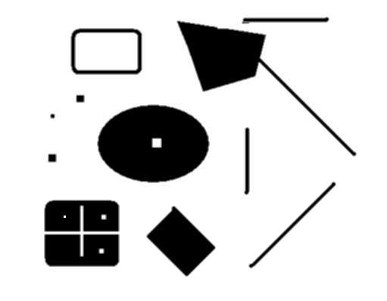
Interest points
original
Suppose you need to click on some point, go away and come back after I deform the image, and click on the same points again.
Which points would you choose?
deformed

Slide 9


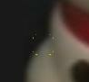

Keypoint matching
1. Find a set of distinctive key- points
A₁
B₃
2. Define a region around each keypoint
A₂
A₃
3. Extract and normalize the region content
B₁
B₂
4. Compute a local descriptor from the normalized region
5. Match local descriptors

Slide 10
Goals for keypoints
Detect points that are repeatable and distinctive

Slide 11
Key trade-offs
A₁
B₃
A₂
A₃
B₂
B₁
Detection of interest points
More Repeatable
More Points
Robust detection
Precise localization
Robust to occlusion
Works with less texture
Description of patches
More Distinctive
More Flexible
Minimize wrong matches
Robust to expected variations
Maximize correct matches

Slide 12
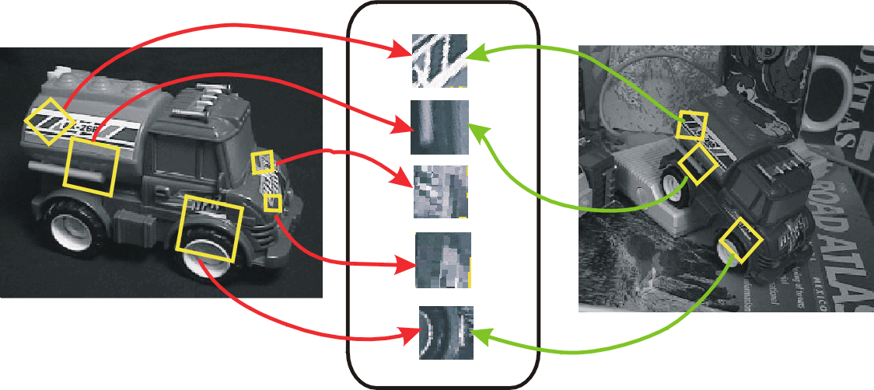
Invariant local features
Image content is transformed into local feature coordinates that are invariant to translation, rotation, scale, and other imaging parameters
Features Descriptors

Slide 13
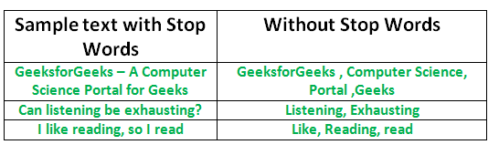
Natural Language
Stop words: occur frequently but do not contain much information

Slide 14
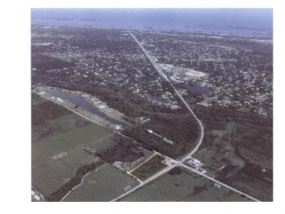
Choosing interest points
Where would you tell your friend to meet you?
Notes:
Corners!

Slide 15
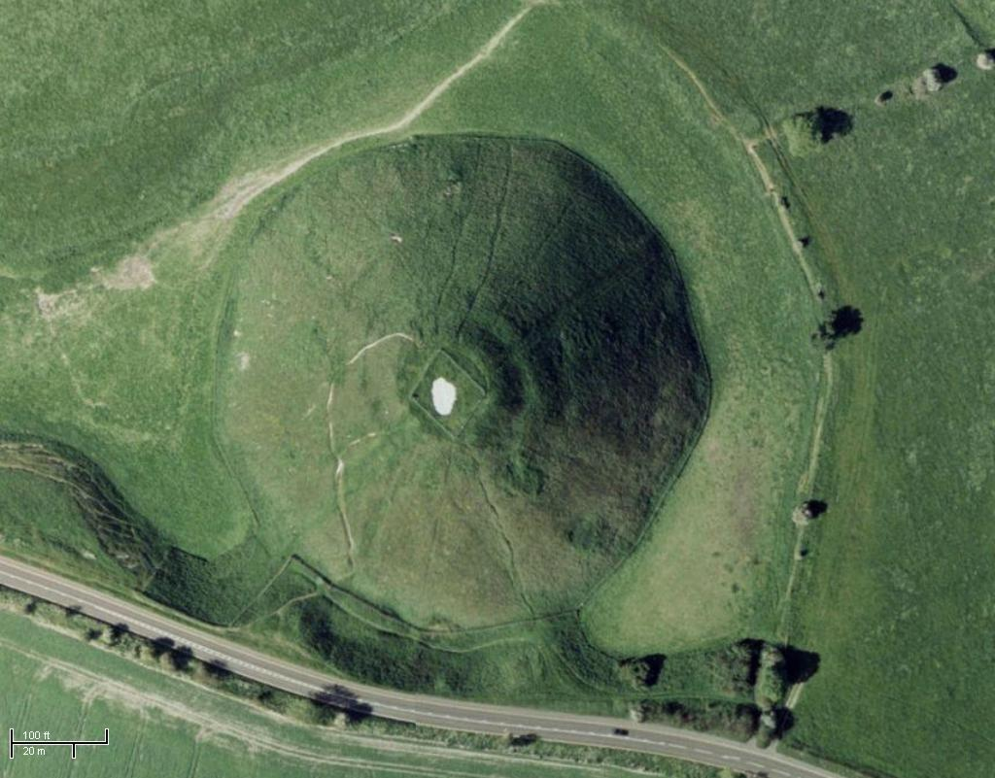
Choosing interest points
Where would you tell your friend to meet you?
Notes:
Blobs!

Slide 16
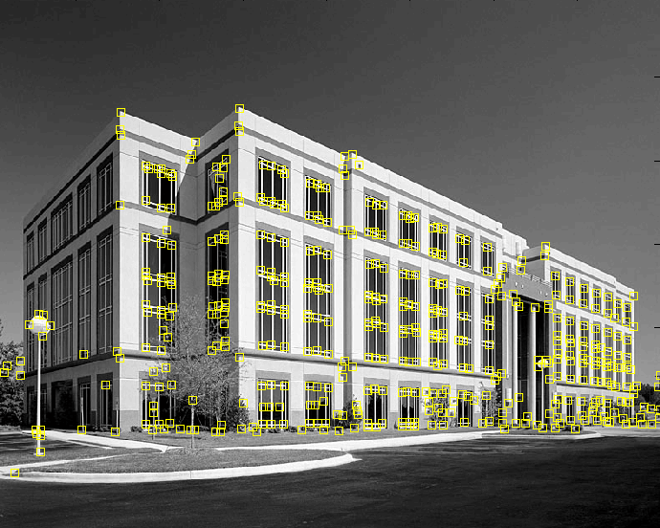
Feature extraction: Corners
Notes:
http://g.co/maps/qcrr3 google street view

Slide 17


Why extract features?
Motivation: panorama stitching
We have two images – how do we combine them?

Slide 18

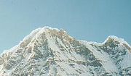
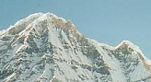
Local features: main components
Detection: Identify the interest points
Description: Extract vector feature descriptor surrounding each interest point.
Matching: Determine correspondence between descriptors in two views

Slide 19

Characteristics of good features
Repeatability
The same feature can be found in several images despite geometric and photometric transformations
Saliency
Each feature is distinctive
Compactness and efficiency
Fewer features than image pixels
Locality
A feature occupies a relatively small area of the image; robust to clutter and occlusion

Slide 20
Interest operator repeatability
We want to detect (at least some of) the same points in both images
Yet we have to be able to run the detection procedure independently per image
No chance to find true matches!
Notes:
20

Slide 21
Descriptor distinctiveness
We want to be able to reliably determine which point goes with which
Must provide some invariance to geometric and photometric differences between the two views
?

Slide 22
Local features: main components
Detection: Identify the interest points
Description: Extract vector feature descriptor surrounding each interest point
Matching: Determine correspondence between descriptors in two views

Slide 23
Many detectors
Hessian & Harris [Beaudet ‘78], [Harris ‘88]
Laplacian, DoG [Lindeberg ‘98], [Lowe 1999]
Harris-/Hessian-Laplace [Mikolajczyk & Schmid ‘01]
Harris-/Hessian-Affine [Mikolajczyk & Schmid ‘04]
EBR and IBR [Tuytelaars & Van Gool ‘04]
MSER [Matas ‘02]
Salient Regions [Kadir & Brady ‘01]
Others…

Slide 24

Corner detection
We should easily recognize the point by looking through a small window
Shifting a window in any direction should give a large change in intensity
“flat” region: no change in all directions
“edge”: no change along the edge direction
“corner”: significant change in all directions

Slide 25
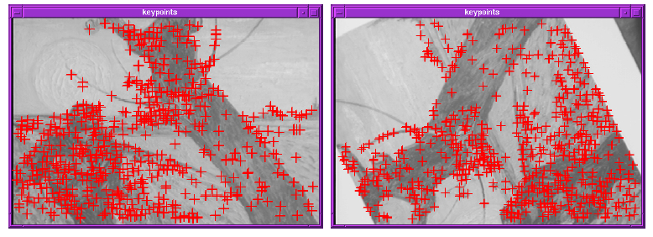
Finding corners
Key property: in the region around a corner, image gradient has two or more dominant directions
Corners are repeatable and distinctive

Slide 26
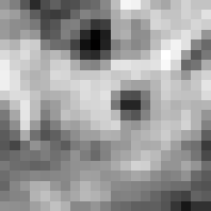

Corner detection: Mathematics
Change in appearance of window w(x,y)
for the shift [u,v]:
I(x, y)
E(u, v)
E(3,2)
w(x, y)

Slide 27
Corner detection: Mathematics
Change in appearance of window w(x,y)
for the shift [u,v]:
I(x, y)
E(u, v)
E(0,0)
w(x, y)

Slide 28
Corner detection: Mathematics
Change in appearance of window w(x,y)
for the shift [u,v]:
Window function
Shifted intensity
Intensity
Window function w(x,y) =
or
1 in window, 0 outside
Gaussian

Slide 29
Moravec corner detector
Test each pixel with change of intensity for the shift [u,v]:
Window function
Shifted intensity
Intensity
Four shifts: (u,v) = (1,0), (1,1), (0,1), (-1, 1)
Look for local maxima in min{E}
When does this idea fail?

Slide 30
Moravec corner detector
In a region of uniform intensity, then the nearby patches will look similar.
On an edge, then nearby patches in a direction perpendicular to the edge will look quite different, but nearby patches in a direction parallel to the edge will result in only a small change.
On a feature with variation in all directions, then none of the nearby patches will look similar.
“flat” region: no change in all directions
“edge”: no change along the edge direction
“corner”: significant change in all directions
Four shifts: (u,v) = (1,0), (1,1), (0,1), (-1, 1)
Look for local maxima in min{E}

Slide 31
Problem of Moravec detector
Only a set of shifts at every 45 degree is considered
Noisy response due to a binary window function
Only minimum of E is taken into account
Harris corner detector (1988) solves these problems.
C. Harris and M. Stephens. "A Combined Corner and Edge Detector.“ Proceedings of the 4th Alvey Vision Conference: pages 147--151.

Slide 32
Corner detection: Mathematics
Change in appearance of window w(x,y)
for the shift [u,v]:
We want to find out how this function behaves for small shifts
E(u, v)

Slide 33
Corner detection: Mathematics
Change in appearance of window w(x,y)
for the shift [u,v]:
We want to find out how this function behaves for small shifts
Local quadratic approximation of E(u,v) in the neighborhood of (0,0) is given by the second-order Taylor expansion:

Slide 34
Taylor series
Taylor series of the function f at a
Maclaurin series (Taylor series when a=0)

Slide 35
Taylor expansion
Second order Taylor expansion for vectors
Local quadratic approximation of E(u,v) in the neighborhood of (0,0) is given by the second-order Taylor expansion:

Slide 36
Corner detection: Mathematics
Second-order Taylor expansion of E(u,v) about (0,0):

Slide 37
Corner detection: Mathematics
Second-order Taylor expansion of E(u,v) about (0,0):

Slide 38
Corner detection: Mathematics
The quadratic approximation simplifies to
where M is a second moment matrix computed from image derivatives:
M

Slide 39
Simpler Derivation of E(u,v)

Slide 40
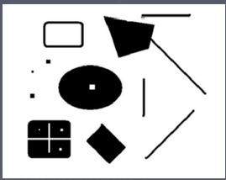
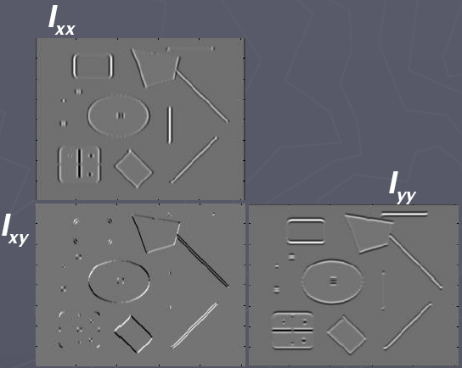
Corners as distinctive Interest Points
2 x 2 matrix of image derivatives (averaged in neighborhood of a point).
Notation:

Slide 41
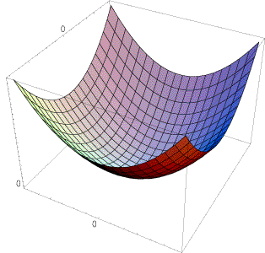
Interpreting the second moment matrix
The surface E(u,v) is locally approximated by a quadratic form. Let’s try to understand its shape.

Slide 42
Interpreting the second moment matrix
First, consider the axis-aligned case (gradients are either horizontal or vertical)
Diagonalization of M
Here, λ₁ and λ₂ are eigenvalues of M (and R is a
matrix consisting of eigenvectors)
If either λ is close to 0, then this is not a corner, so look for locations where both are large.

Slide 43
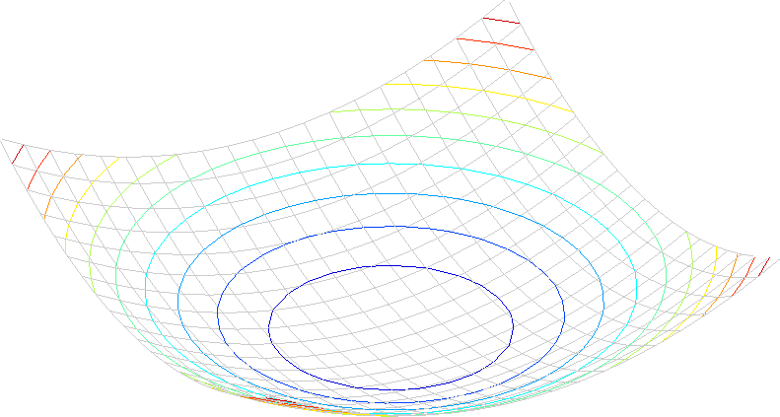
Interpreting the second moment matrix
Consider a horizontal “slice” of E(u, v):
This is the equation of an ellipse.

Slide 44
Interpreting the second moment matrix
Consider a horizontal “slice” of E(u, v):
This is the equation of an ellipse.
Diagonalization of M:
The axis lengths of the ellipse are determined by the eigenvalues and the orientation is determined by R
direction of the fastest change
direction of the slowest change
(λ_{max})^{-1/2}
(λ_{min})^{-1/2}

Slide 45
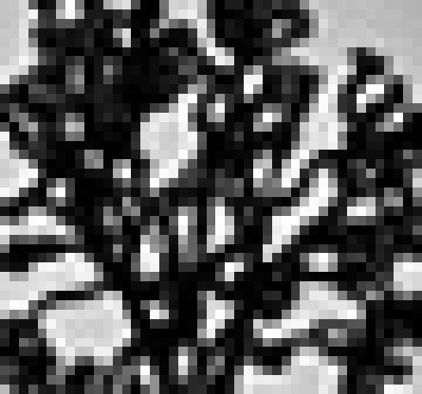
Visualization of second moment matrices

Slide 46
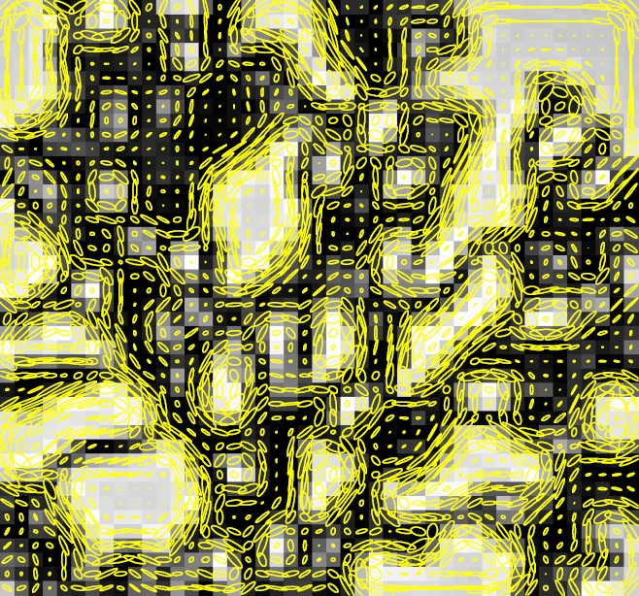
Visualization of second moment matrices

Slide 47
Interpreting the eigenvalues
Classification of image points using eigenvalues of M:
“Edge” λ₂ >> λ₁
“Corner” λ₁ and λ₂ are large, λ₁ ~ λ₂; E increases in all directions
λ₂
λ₁ and λ₂ are small; E is almost constant in all directions
“Flat” region
“Edge” λ₁ >> λ₂
λ₁

Slide 48
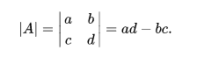
Corner response function
α: constant (0.04 to 0.06)
“Edge” R < 0
“Corner” R > 0
recall
R is a matrix with two orthonormal bases
(eigenvector of unit norm)
|R| small
“Flat” region
“Edge” R < 0

Slide 49
Harris corner detector
Compute M matrix for each image window to get their cornerness scores.
Find points whose surrounding window gave large corner response (f>threshold)
Take the points of local maxima, i.e., perform non-maximum suppression
Notes:
49

Slide 50

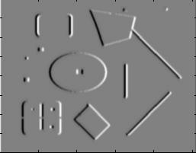
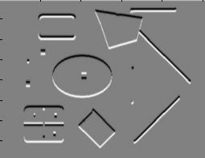
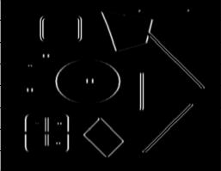
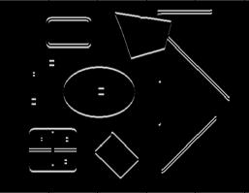
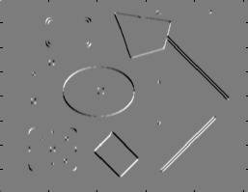
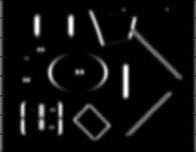
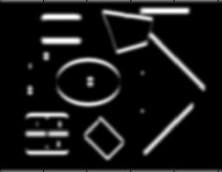
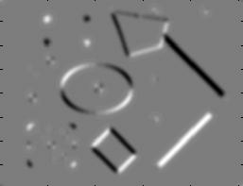
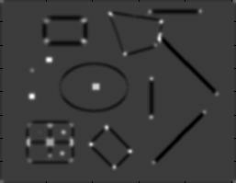
Harris corner detector [Harris88]
Second moment matrix
1. Image derivatives
I_{x}
I_{y}
(optionally, blur first)
I_{x}²
I_{y}²
I_{x}I_{y}
2. Square of derivatives
3. Gaussian filter g(σ_{I})
g(I_{x}²)
g(I_{y}²)
g(I_{x}I_{y})
recall
4. Cornerness function – both eigenvalues are strong
5. Non-maxima suppression
har

Slide 51

Harris Detector: Steps

Slide 52

Harris Detector: Steps
Compute corner response R

Slide 53

Harris Detector: Steps
Find points with large corner response: R>threshold

Slide 54
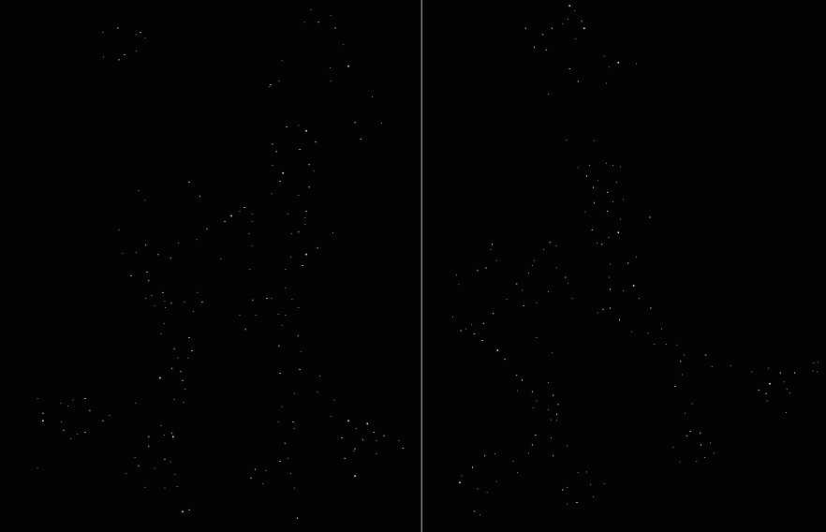
Harris Detector: Steps
Take only the points of local maxima of R

Slide 55

Harris Detector: Steps

Slide 56
Invariance and covariance
We want corner locations to be invariant to photometric transformations and covariant to geometric transformations
Invariance: image is transformed and corner locations do not change
Covariance: if we have two transformed versions of the same image, features should be detected in corresponding locations

Slide 57
Affine intensity change
I → a I + b
Only derivatives are used => invariance to intensity shift I → I + b
Intensity scaling: I → a I
R
R
threshold
x (image coordinate)
x (image coordinate)
Partially invariant to affine intensity change

Slide 58
Image translation
Derivatives and window function are shift-invariant
Corner location is covariant w.r.t. translation

Slide 59
Image rotation
Second moment ellipse rotates but its shape (i.e. eigenvalues) remains the same
Corner location is covariant w.r.t. rotation

Slide 60
Scaling
Corner
All points will be classified as edges
Corner location is not covariant to scaling!

Slide 61
More local features
SIFT (Scale Invariant Feature Transform)
Harris Laplace
Harris Affine
Hessian detector
Hessian Laplace
Hessian Affine
MSER (Maximally Stable Extremal Regions)
SURF (Speeded-Up Robust Feature)
BRIEF (Boundary Robust Independent Elementary Features)
ORB (Oriented BRIEF)

